Slide 1
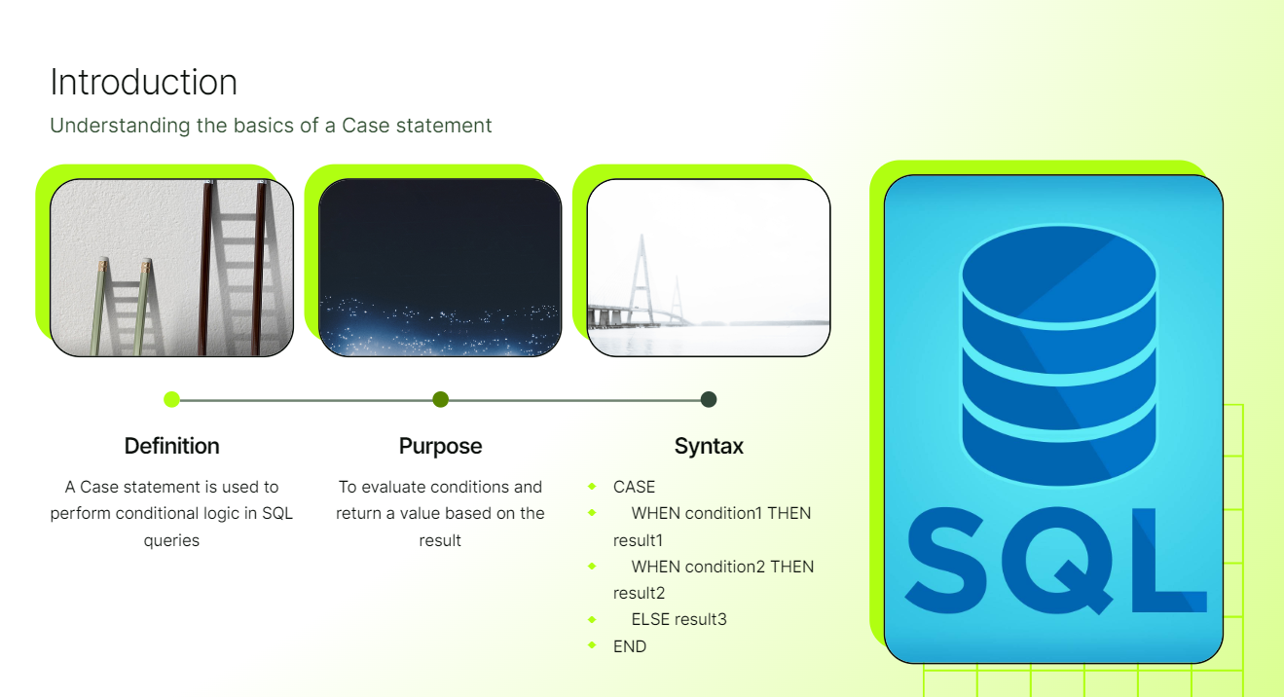
CASE STATEMENT

Slide 2
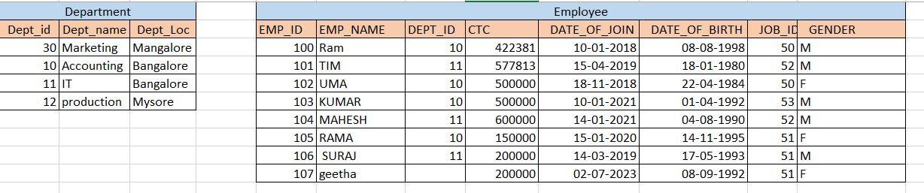
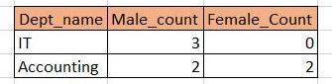
Demonstrating a Case statement in action
select dept_name,sum(case when gender = 'M' then 1 else 0 end) as male_count,sum(case when gender = 'F' then 1 else 0 end) as Female_count
from department inner join emps on
emps.dept_id = department.dept_id
group by dept_name

Slide 3
Demonstrating a Case statement in action
Display Department wise employee exist or not Exist
select dept_name,(case when count(emp_name) >=1 then 'Emp Exist' else 'Emp_does not exist' end) as emp_status
from department d left join emps e
on d.dept_id = e.dept_id
group by dept_name
Create a age band based on emps age
select emp_name, round((sysdate-date_of_birth)/365,2) as age,(case when round((sysdate-date_of_birth)/365,2) > 60 then
'Senior citizen' when round((sysdate-date_of_birth)/365,2) > 30
then 'Adult' when round((sysdate-date_of_birth)/365,2) > 16 then 'youngster'
else 'Child' end) as age_group
from emps

